Slide 1
Engineering Design DSN2096
By:
Ramraj Dangi

Slide 2
Syllabus
Introduction to Engineering design process: Design History; Dieter Rams Principles of Good Design; Overview of Engineering Design Process: Problem Formulation, Concept generation, Project Planning and Design Making; Human Centred Design (HCD);
Design Thinking for Innovation: Design Thinking as Mindset, Process and Toolbox., Enhancing Design Thinking Through, Empathy, Interviewing, Questioning & Brainstorming, Tools for Design Thinking: Mind Mapping, Innovation Flowchart – Question ladder – SCAMPER (for products) Journey Mapping, Task analysis grid (for services)
Engineering Design Approaches: Professional and societal Context of Design; Different types of design – Conceptual, Embodiment designs and Detailed designs – Identification and Specifications, Standards and codes, Design Features – Design for Aesthetics, Production, Standards, Minimum risk, Ease of maintenance, Quality, Minimum cost and Optimum Design, Service Design - People - Asserts - policies - culture. Iterative process - Exploration - Creation - Reflection - Implementation.

Slide 3
Syllabus
Usability & Reliability: Usability – User requirement; User experience; Usability testing; Customer Co-creation; Reliability & Safety: Human and equipment, safety, Risk analysis, and security, System reliability; Use of e-engineering: Modelling, Simulation and Verification.
Prototyping and Visualization: Design Cycle Model, Metaphor method: Theory and methodology of concept generation, Blend method & Thematic Method. Conceptual Design & Design capability and sociality. Prototyping & Visualization Design Tools – E-tools
Sustainable Design: Concepts of sustainable development, Sustainable design principles - Design for Environment; Life Cycle Assessment; Models of sustainable design- Biomimicry, Eco Design, Recycling; Social Innovation
Communication: Articulating design ideas: Storytelling; Sketching & Dynamic Diagrams; K Scripts

Slide 4
Books and resources
TEXT BOOKS:
Huge Jack, “Engineering Design, Planning, and Management” Academic Press, 2013.
Gerhard Pahl, Wolfgang Beitz “Engineering Design: A Systematic Approach” 2014.

Slide 5
Unit7: Communication

Slide 6
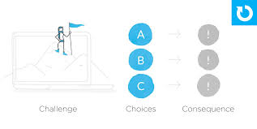
Articulate Design Ideas
At the surface this sounds easy – anyone can talk, but talking isn't the challenge. The challenge is in communicating well.
How can you communicate in a way that convinces your stakeholder(s) that this is the problem to focus on? The meaning behind a particular decision? The goal you're trying to achieve?
Knowing the goal is critical, but keep in mind that the goal can change.
As we progress through the design process, new insights arise which can influence the goal or direction of the project.

Slide 7
Articulate Design Ideas
A big part of any designers job is to convincing others of our design can be key to success.
If we want buy-in from someone, we need to consider their needs and values. This can be helpful in pinpointing what to focus on. For example:
As an engineer I value technical constraints and want to know the technicality required to make this project successful, so I should focus on how to address these.
As a product owner I value business goals and want to know how this is solving the business problem, so I should ensure that I outline how this solution will achieve that.
Equally important as understanding their needs and values is listening.
Listening helps to uncover the real problem and let others be heard.

Slide 8
Defining Designs' Purpose
1. Solve a problem
What problem does this particular design solve? Always refer to the problem, goals and big picture
2. Be easy for users
How does this particular design affect the user? What barriers are we creating or minimizing?
3. Be supported by everyone
There will always be someone who will challenge your decision. Be prepared to explain why it's better than the alternative and the other directions you explored

Slide 9
Documentation Benefits in Articulate Design
Avoids repeat conversations
Focuses on being articulate
Builds trust with stakeholders
Keeps the meeting on track

Slide 10
Storytelling
Storytelling is used in design as a technique to get insight into users, build empathy and access them emotionally. With stories, designers speak via character, theme, melody, and spectacle to increase the appeal of what they offer and provide a solid understanding of the users.
Seven Elements in Storytelling
Plot – what are users trying to achieve/overcome?
Character – who are the users: not just demographically, but what insights do you require to understand what they’re truly like?
Theme – how can you establish a trustworthy presence to them?
Diction – what will your design say to users and how?
Melody – will the overall design pattern appear pleasant and predictable to users, moving them emotionally?
Décor – how will you present everything so the graphics match the setting the users can sense?
Spectacle – how can you make your design outstanding so users will remember it?

Slide 11
Six Rules in Storytelling
Self knowledge and awareness
Clear structure and purpose
Have a character to root
Appeal to our deepest emotions
Surprising and unexpected
Simple and focused

Slide 12
k-Scripts
kscript (https://kscript.org) is a dynamic programming language with expressive syntax, cross platform support, and a rich standard library. Its primary aim is to allow developers to write platform agnostic programs that can run anywhere, and require little or no platform- or os- specific code.
Most people want to use this site, kscript.org, to learn about kscript which contains the developer blog, setup guide, and lots of useful tutorials.
kscript was designed to be a tool useful in many different circumstances – as a computer calculator, as a task-automation language, GUI development language, numerical programming, and more.

Slide 13
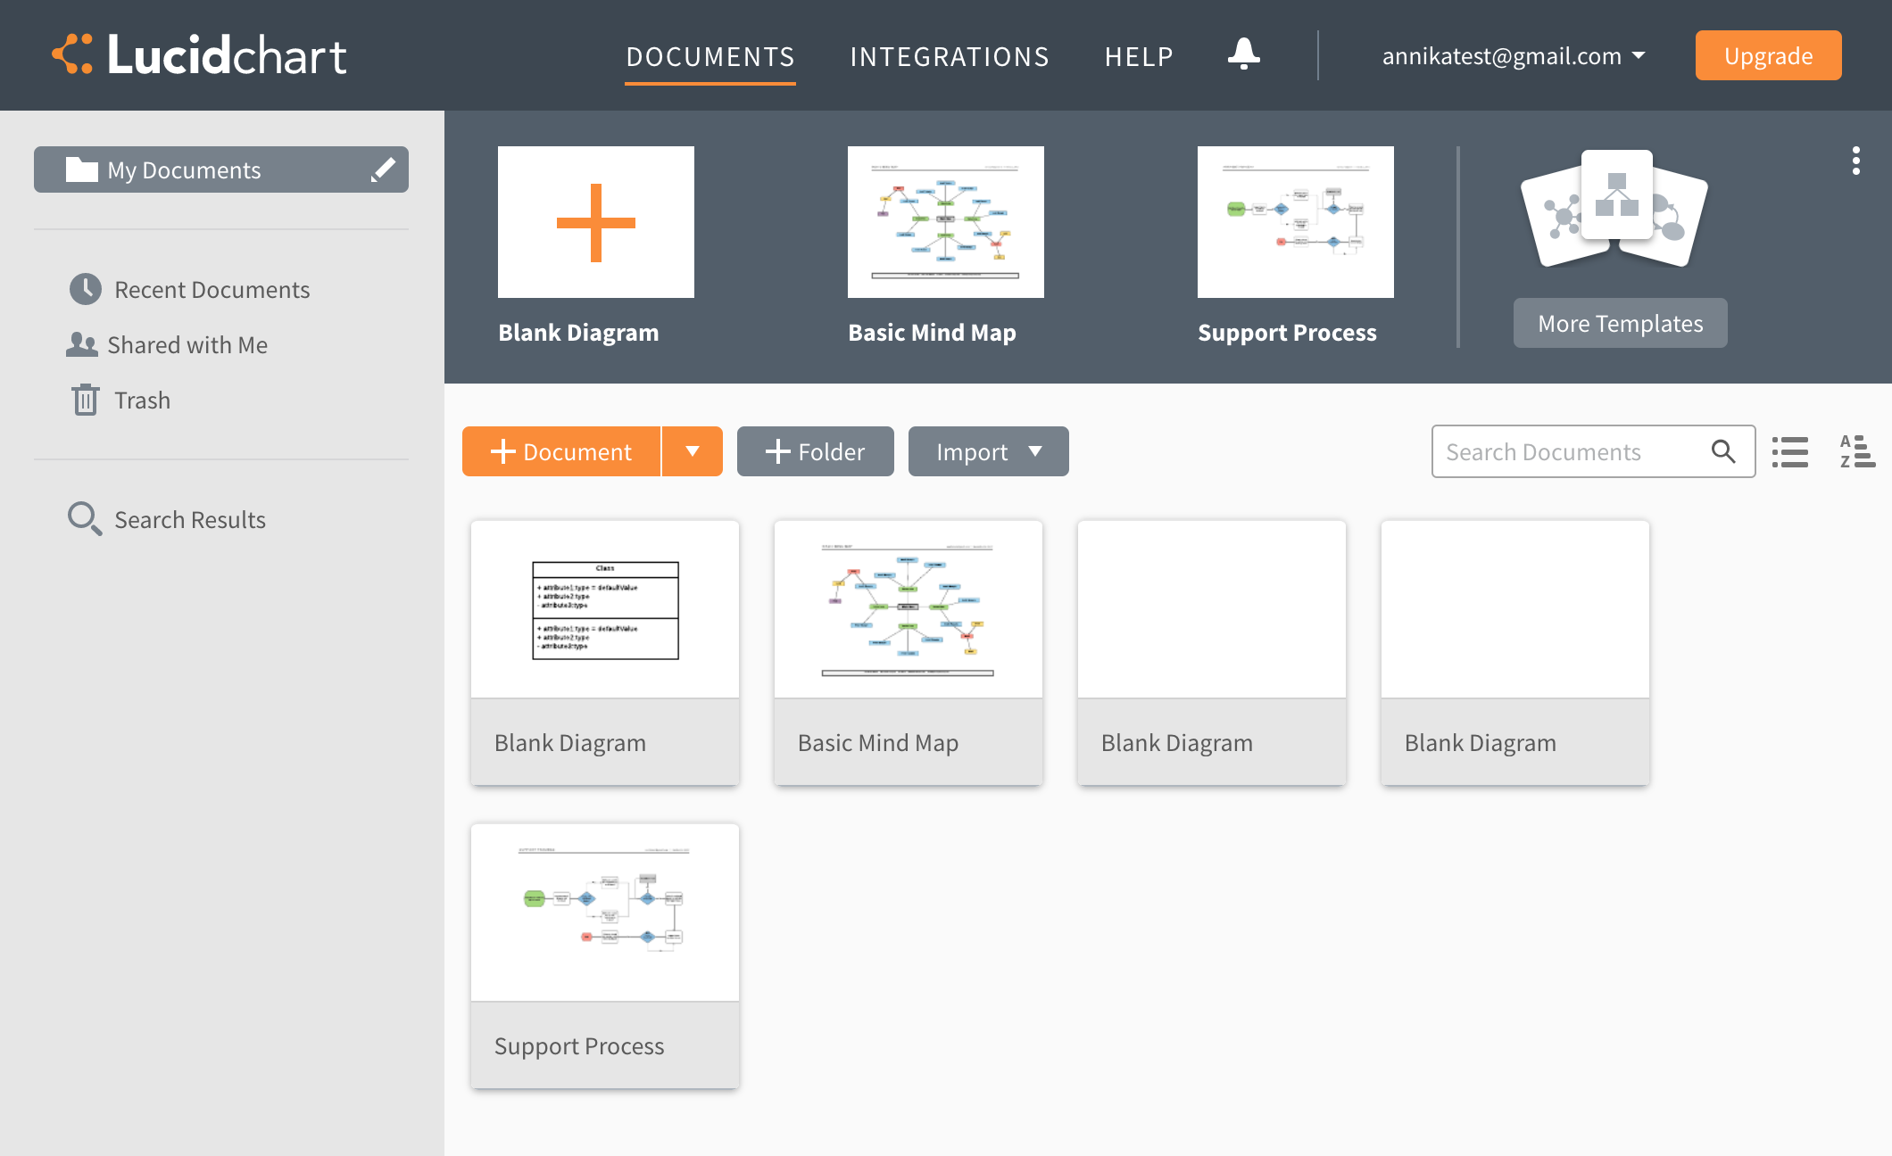
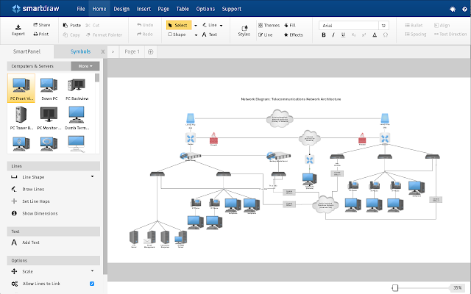
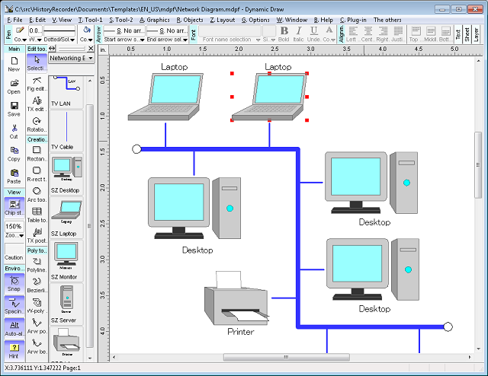
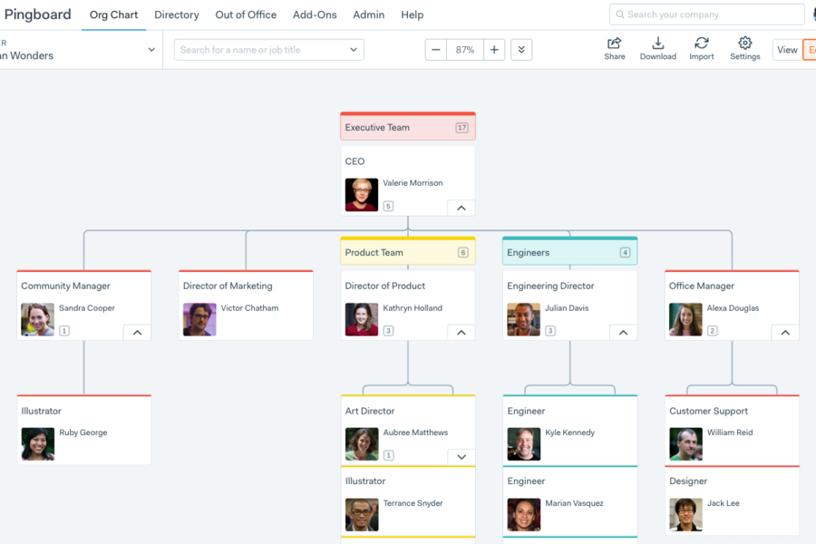
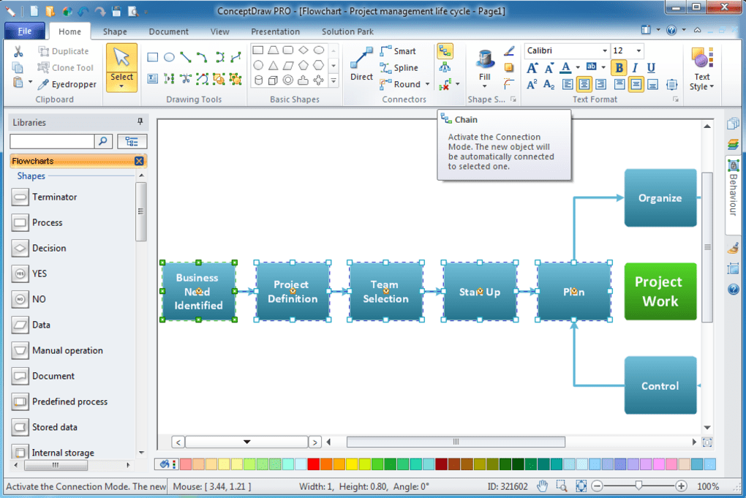
Tools in Sketching and dynamic diagrams
Lucid Chart
Dynamic Draw
Smart Draw
Concept Draw
Pingboard

Slide 14
Thanks!

